Slide 1
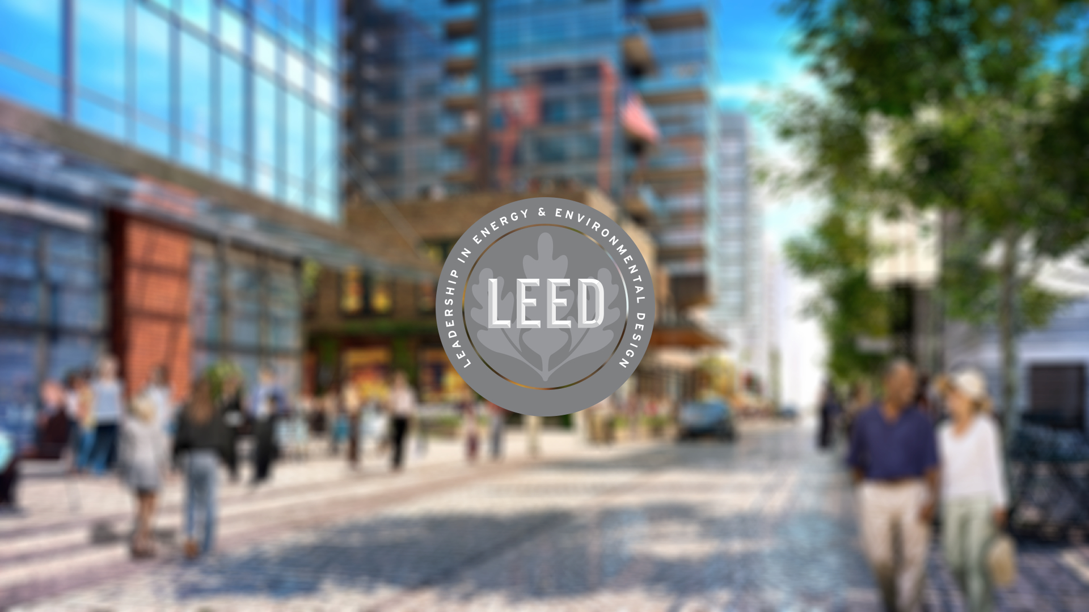
Notes:
LEED is the world’s rating system for the design, construction and operation of high-performance green buildings. For the last 18 years, the various versions of LEED have pushed the global green building market forward progressively, with more than 93,000 registered and certified projects and a total of 19.3 billion square feet of space used worldwide.
In a world that is constantly evolving, one of the hallmarks of LEED is “continuous improvement.” With each new version, LEED raises the bar to increase the impact on our built environment. USGBC has also been working to ensure that LEED not only meets different markets where they are, but also that the rating system accelerates the speed with which the market moves.
Ensures sustainability, resource efficiency, and is better for the bottom line
Concise framework for identifying & implementing practical & measurable green building design, construction, operations & maintenance strategies and solutions.
After the widespread success of LEED 2009, we wanted to raise the bar on the market. As green builders, it’s not just our job to be efficient with our construction and design, but to give the environment more than we receive. Today, LEED v4 is the most rigorous green building rating system in the world. From improving energy performance to emphasizing human health and integrative building design, LEED is encouraging project teams to operate beyond the status quo.
Enter LEED v4.1: LEED v4.1 is not a full version change, but rather an incremental update to the LEED rating systems. LEED v4.1 will be our most inclusive and transparent platform to date. That’s because our most important requirement for adoption will come from our most valuable resource of all—you!

Slide 3
U.S. GREEN BUILDING COUNCIL

Slide 5
Notes:
LEED is driving international green building practices with more than 91,700 projects participating in LEED across 167 countries and territories worldwide and 2.2 million square feet of construction space certifying everyday.

Slide 6
Notes:
Reduces operating costs
Lowers employee absenteeism and turnover
Higher resale value
Faster lease up rates

Slide 10
Notes:
Integrative Design

Slide 11
Notes:
Third-party verification helps guarantee that each project saves energy, water and other resources, reducing the overall environmental impact.

Slide 15
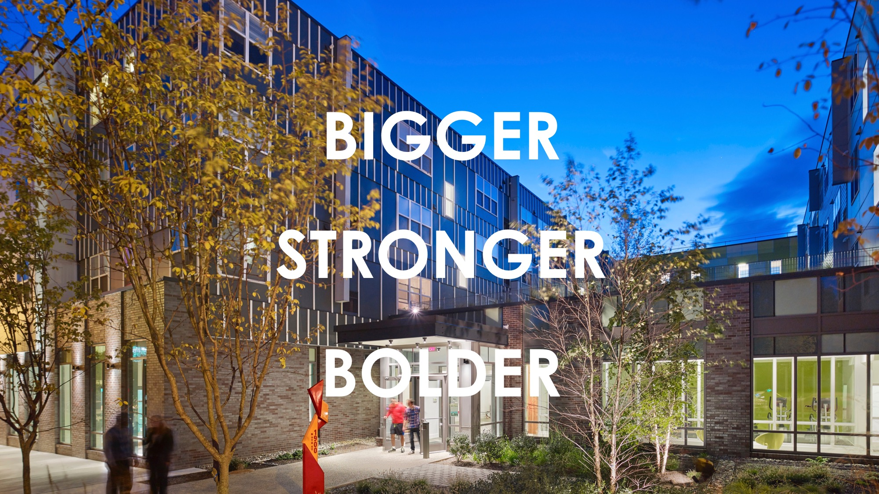
Notes:
LEED v4.1 is bigger, stronger, bolder:
Bigger: LEED v4.1 is for all – it is more inclusive and allows projects to earn LEED points through building performance monitoring, scoring and analytics powered by Arc.
Stronger: LEED v4.1 continues to drive performance. In fact, performance outcomes are fully integrated into LEED v4.1 so that you can measure performance on an ongoing basis.
Bolder: Lessons learned from those in the market using LEED v4 and over the last twenty years have led us to take a deeper look at existing buildings, residential projects and cities to develop unique solutions that address unique markets.
ALL IN
LEED v4.1 will deliver:
New methodologies for measuring building performance by working with and supporting projects to track energy, water, waste, transportation and indoor environmental quality
A simple, data-driven path to LEED certification for existing buildings, making it accessible to more projects than any other version of the rating system
Updated referenced standards and performance requirements to ensure that LEED remains the global leader in green building
The LEED system goals have always prioritized reversing contribution to global climate change and the way we’ve prioritized that in LEED v4.1 for existing buildings is the rating system is designed to reward energy efficiency and greenhouse gas emissions reductions.
This is the first time LEED is using a greenhouse gas metric to award certification in the energy and transportation categories.

Slide 16
Notes:
Simplify requirements that are confusing to project teams
Update requirements that, in practice, have not produced intended goals or outcomes
Make BD+C more accessible to diverse building projects

Slide 17
Notes:
LEED v4 has been in the market for four years; USGBC must update referenced standards to advance sustainable transformation of the built environment
Incorporate successful pilot credit strategies into credit requirements
Apply lessons learned from LEED v4 projects teams

Slide 18
Notes:
Align requirements across design and construction and existing building rating systems
Adjust credit weightings as needed to prioritize strategies that enable sustainable performance throughout the building life cycle
After initial building certification, provide streamlined pathway for ongoing, data-driven performance certification
Require projects to consistently report transportation, energy, water, waste and human health performance data following initial building certification
Empower teams to track and assess holistic building performance against targets established during project design
Link new construction strategies to intended outcomes and key performance indicators

Slide 19
Substitute any LEED v4 credit with LEED v4.1 Who knew “.1” could deliver so much

Slide 20
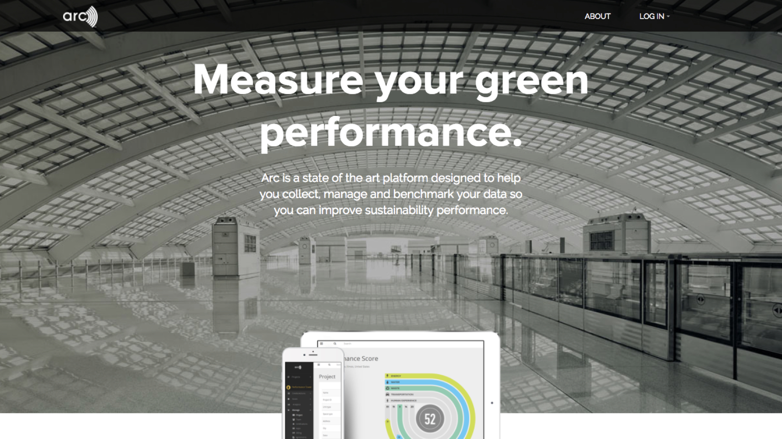
Notes:
- Supports continuous progress toward a better building and higher occupant satisfaction
- Helps a building set performance goals and implement strategies to reach those goals
- Tracks performance data then translates it into a tangible, actionable score
- Leverages a wide range of rating systems, standards, protocols and guidelines

Slide 22
JOIN US!
National Memberships
Local Memberships
USGBC Detroit Region & USGBC West Michigan
Notes:
2030 Districts – works with buildings to reduce energy, water & GHG emissions.

