Slide 1
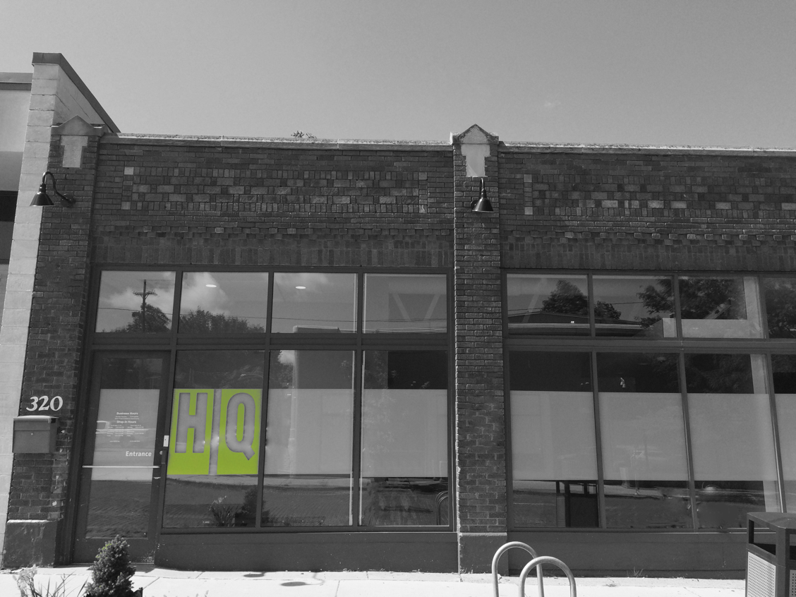
A day in the life of…
a youth who is homeless

Slide 2
A PLACE TO BELONG.
OUR MISSION:
To create a safe and affirming space for youth to find rest, build connections and pursue their passions to realize their dreams.
OUR VISION:
To break the cycle of homelessness.
CORE VALUES:
Relationships First
Safety + Inclusion
Innovation + Flexibility
Bold, Authentic + Transparent
Notes:
HQ exists to be a space where youth can get recharged. It’s a place where you dont have to expend more energy but you can gather it, refill the tank…
HQ opened in December of 2014 with a mission of...
History of start up:
Myself and the other co-founder had both worked in the fields of childhood trauma, sexual exploitation and youth homelessness, observed a gap, researched emerging models, garnered early support and built…with youth providing insight throughout the process.
What makes us unique is our Core values:
Relationships First (belonging →thriving)
Safety + Inclusion (passive inclusion vs actively celebrating the things that make us unique)
Innovation + Flexibility (funding,
Bold, Authentic + Transparent (equity, housing, hold our community accountable, etc)

Slide 4
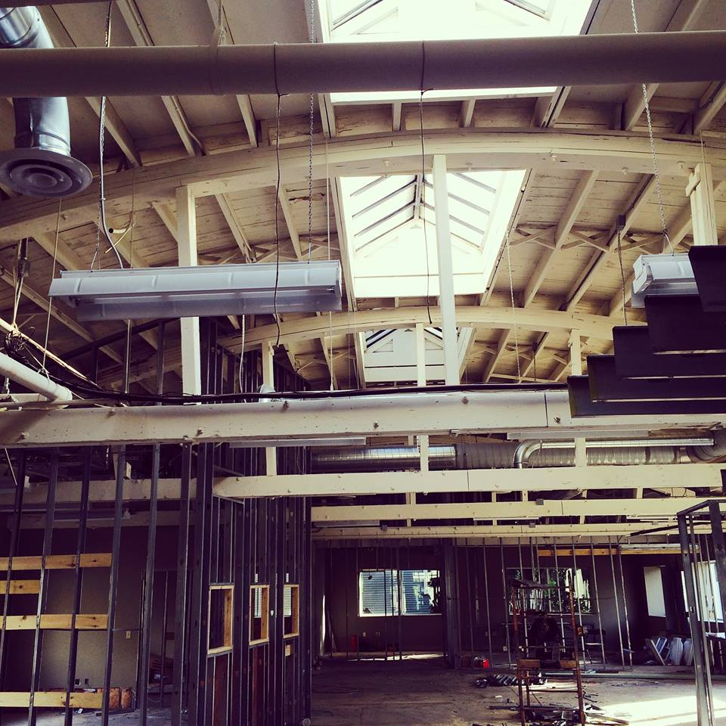
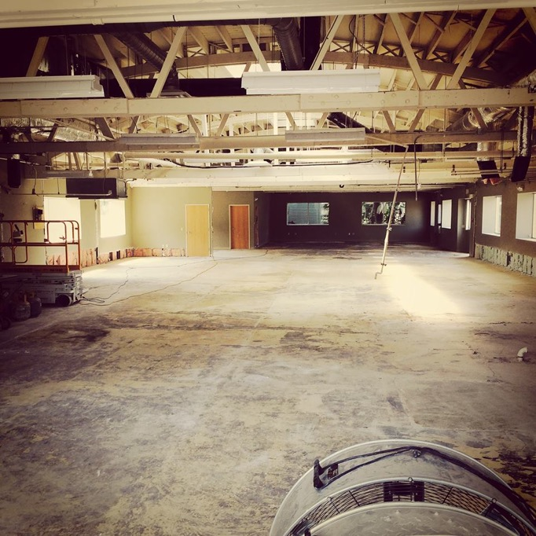
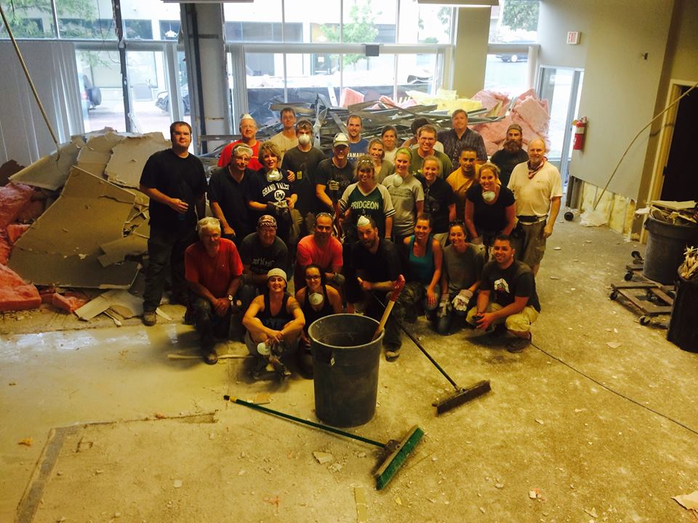

Slide 5
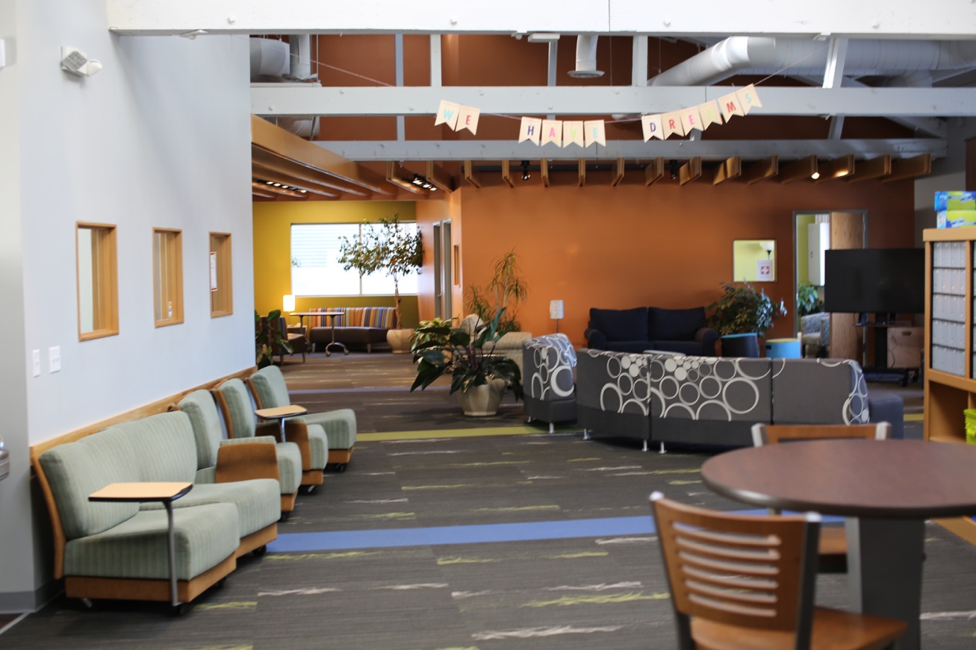
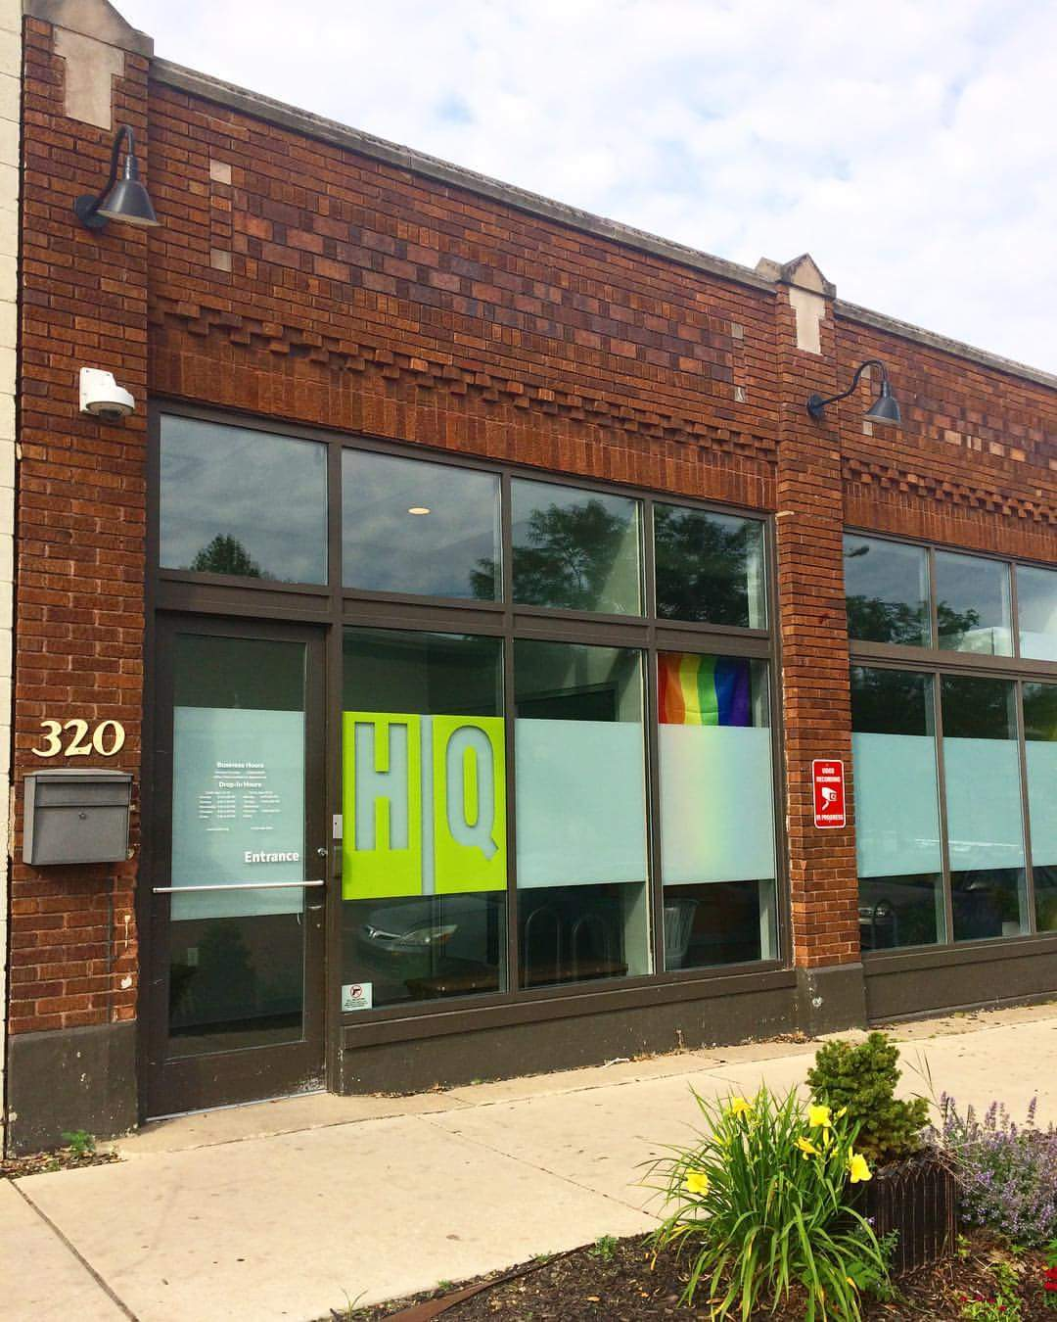
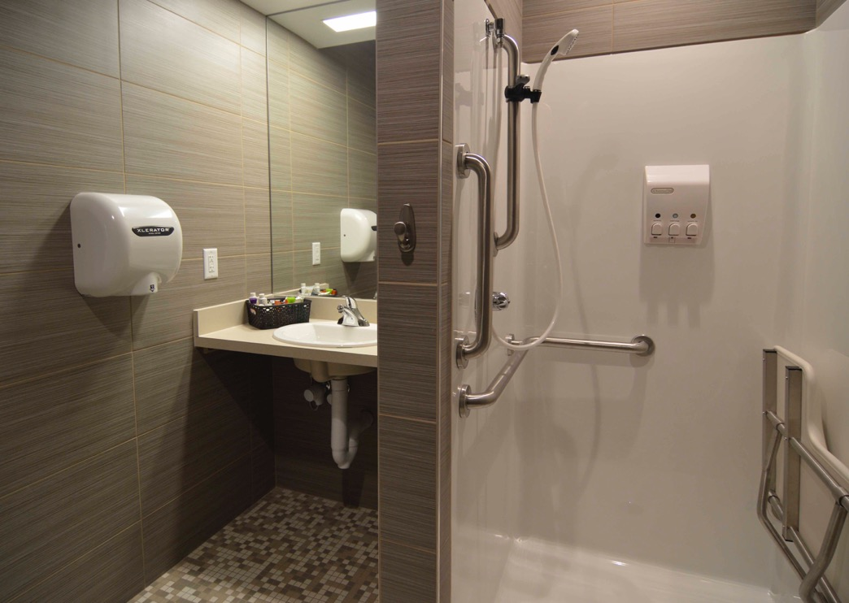
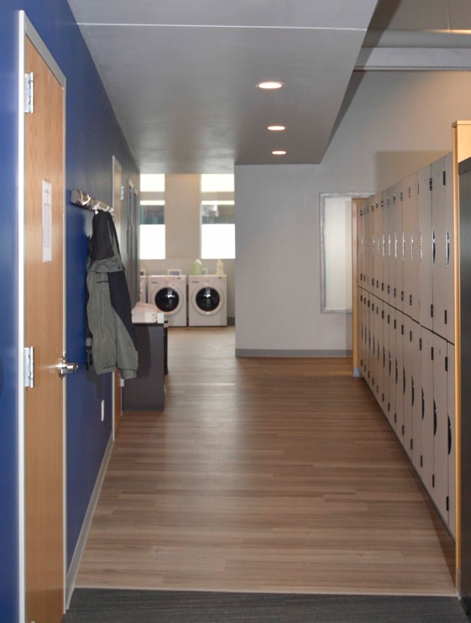
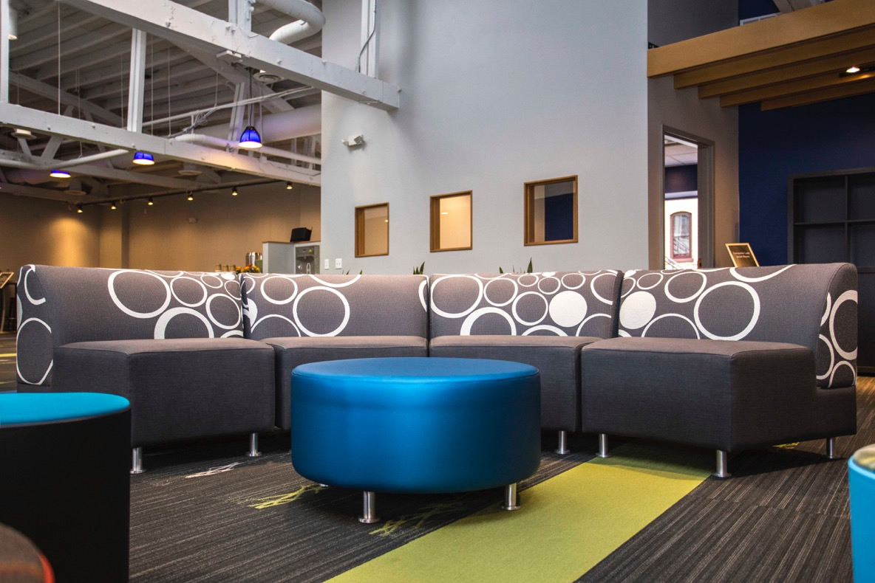
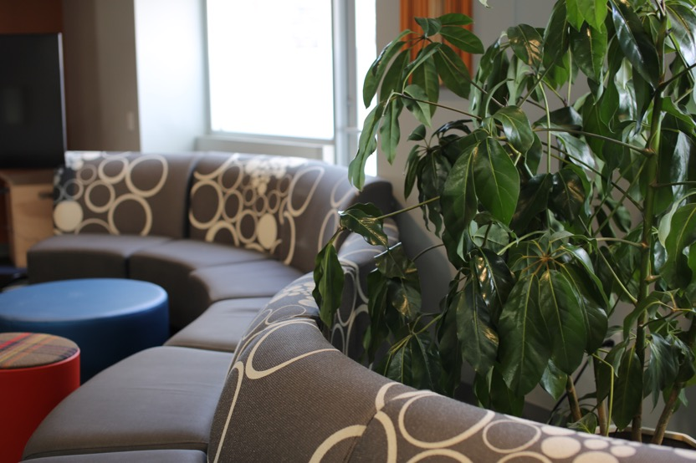
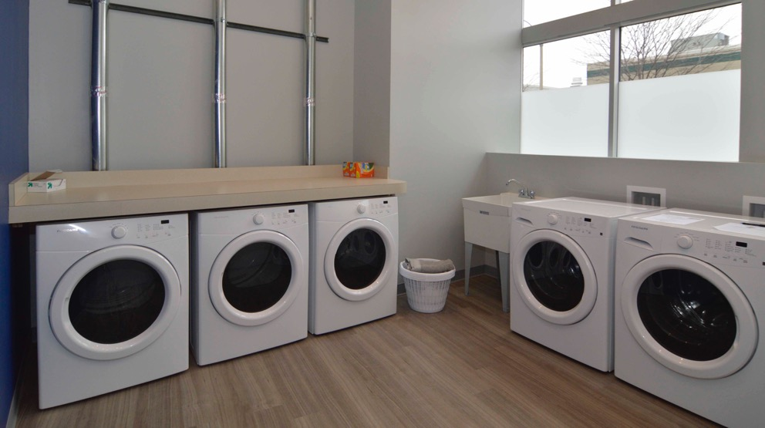

Slide 6
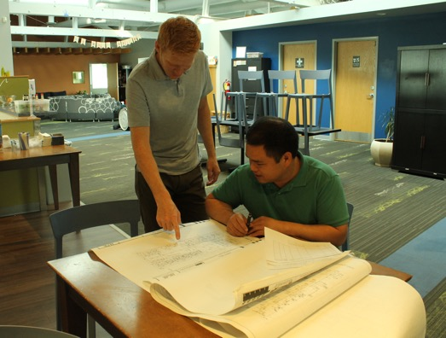
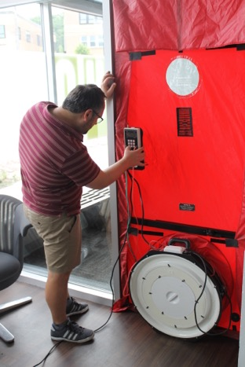
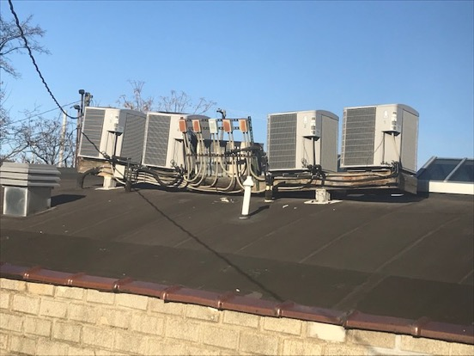
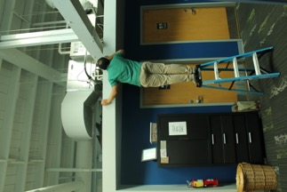
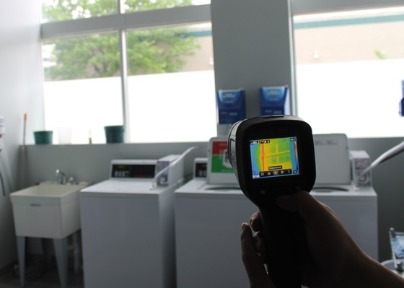
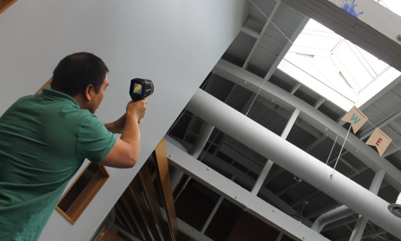
Issues
Water leaks in
Air leaks in/out
Damage to drywall, furniture and carpet
Inconsistent temperature control
Higher than expected energy costs

Slide 7
Opportunities
Immediate financial savings
Green Umbrella Fund
Reinvesting in the mission
Outcomes (to be tracked)
Decreased energy costs
Less frequent maintenance calls
Smaller carbon footprint
Growing funds for future improvements
A safe and affirming space for years to come!

Slide 8
FOLLOW THE PROGRESS
ON FACEBOOK: HQGrandRapids
Wanna see the space for yourself?
Come to a Fourth Friday tour! Register at HQGR.org.
Shandra Steininger, LMSW
Co-Founder + Executive Director at HQ EMAIL: ssteininger@hqgr.org
WEB: www.hqgr.org
PHONE: 616.406.3945

