Slide 1
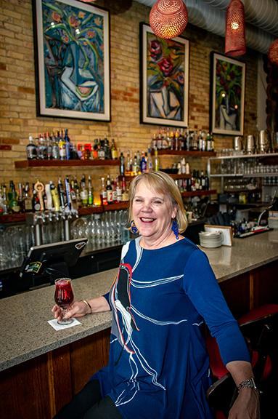
Energy Efficiency at San Chez Restaurant Inc.
Cindy Schneider

Slide 2
What’s your mission?

Slide 3
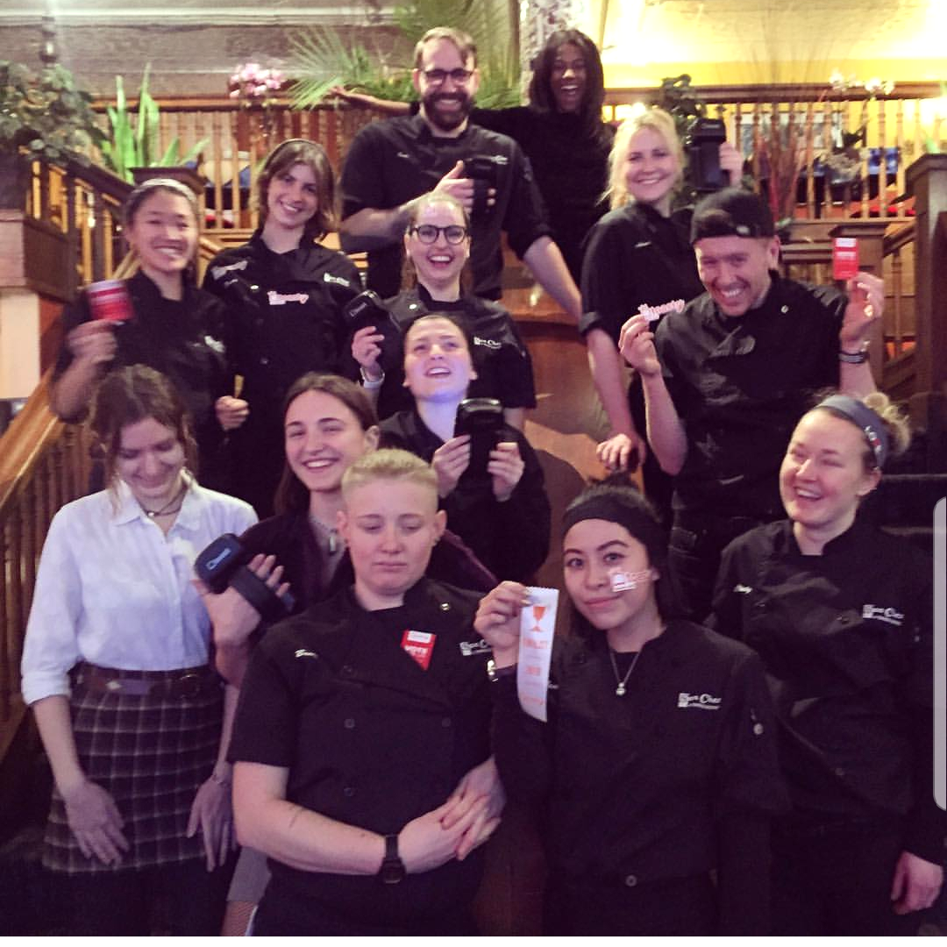
Our Mission
“Our goal is to be West Michigan’s best restaurant company, for our employees, guests and the community.
For our employees, San Chez Restaurant, Inc. will be a clean, safe, friendly, fun, and environmentally responsible place to work, while fostering teamwork, respect, and pride.
San Chez Restaurant, Inc. will provide its guests with world-class food and service while exceeding their expectations in a uniquely entertaining atmosphere.
As a part of the community, San Chez Restaurant, Inc. will be a source of local pride and community support through its demonstrated caring, contribution, ethics, and respect.”

Slide 4
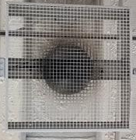

How does this relate to Energy Efficiency
01
Environmentally Conscious Business
02
Reduce cost associated with consumption
03
Energy Efficiency is a complex problem

Slide 5
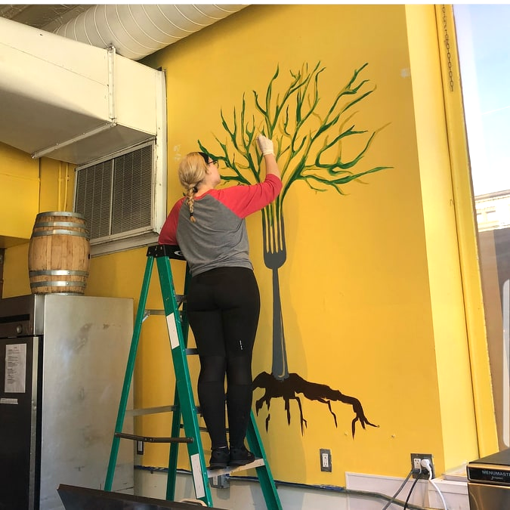
Inviting Staff To Participate
Result of Staff Survey
Promoting education
Empowering people
Retaining talent
Staff members are from all over the world
Now more staff are likely to discuss environmental solutions and issues
Environmental conscious as managing energy and waste as a lifestyle
Staff members are excited to explore new ways of improving our system
50% of staff members have donated resources to a local nonprofit

Slide 6

Tirelessly Investing in our local community
Improving efficiency of our supply chain
High quality products available
Build personal relationships

Slide 7
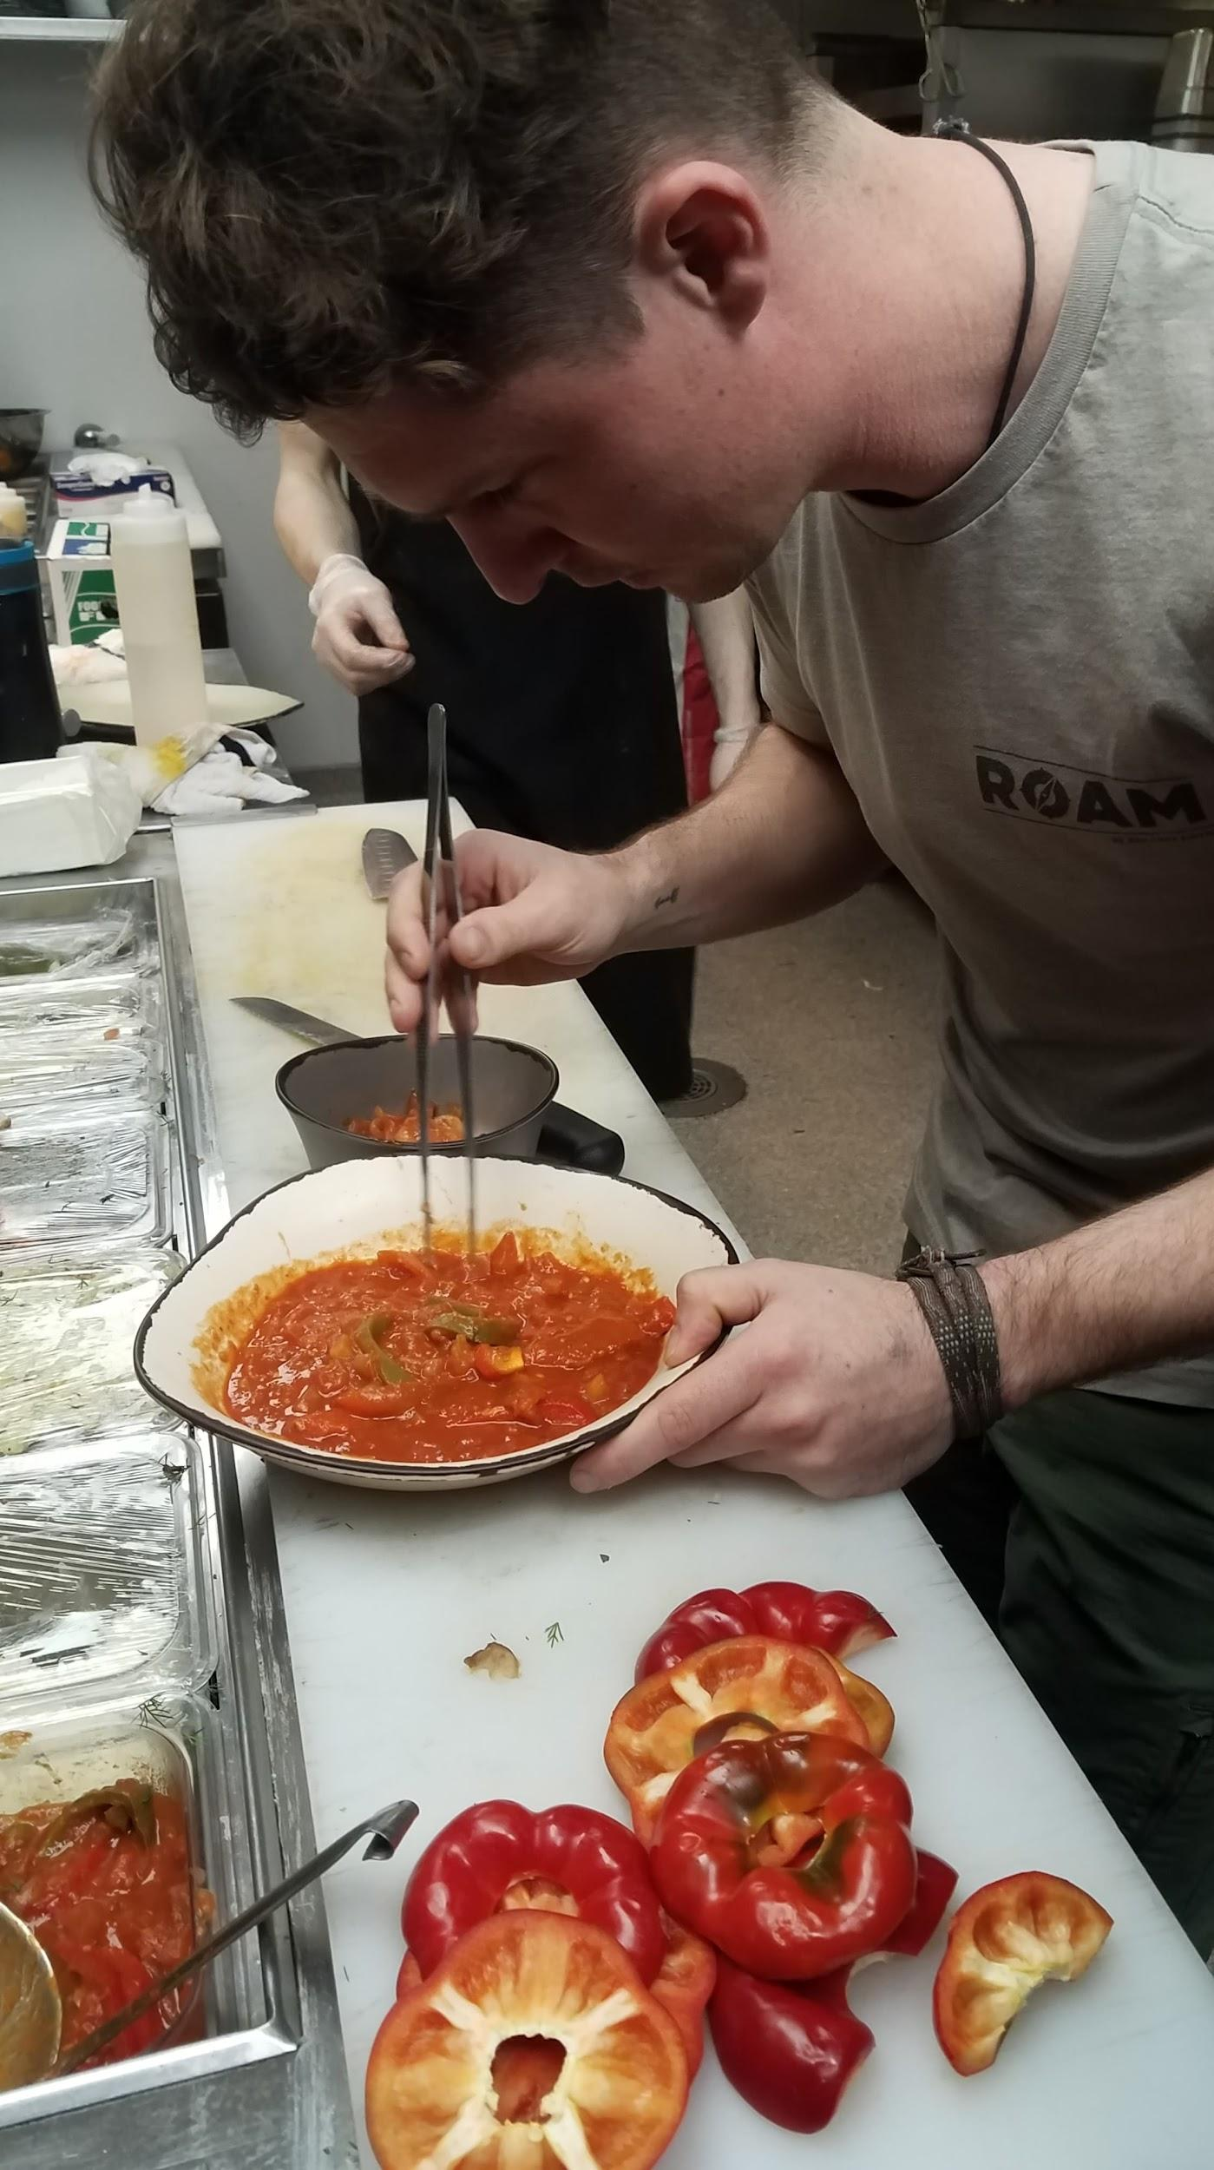
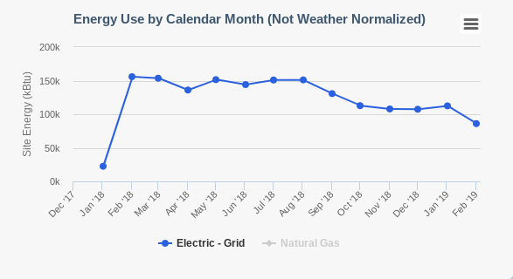
Survey
Thank you to our community
Comparison February 2018-
February 2019
Reduced our usage by 40%

Slide 8
Thanks for listening!

