Slide 1
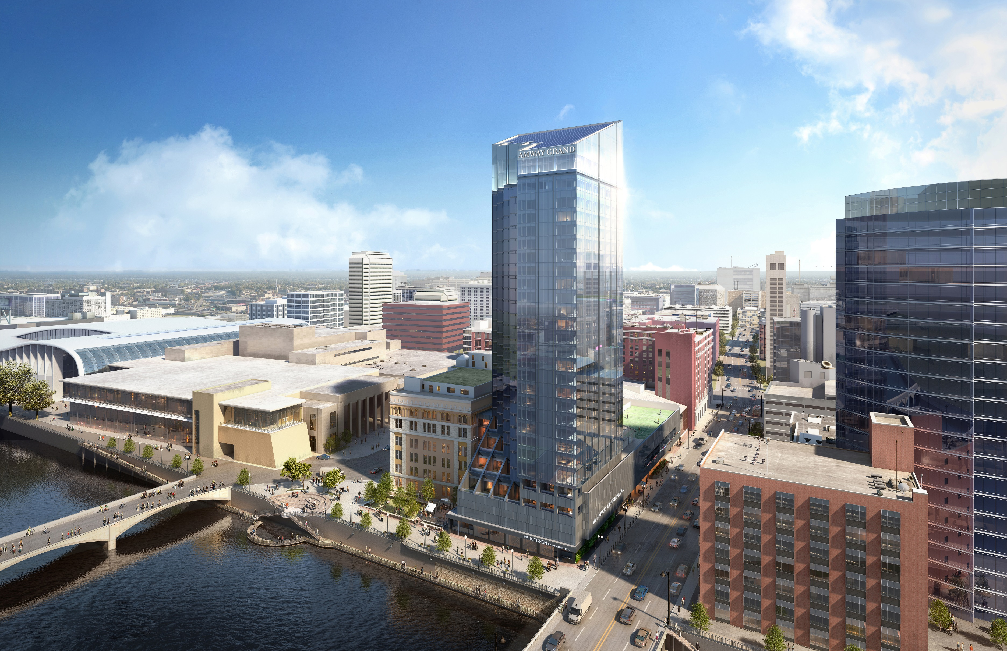
AMWAY GRAND HOTEL GLASS PERFORMANCE DRIVERS
Notes:
Tower after completion
Maintain Iconic Sloped Roof
Maintain balance between the Amway Grand Plaza and JW Marriott.
a. Try and compliment each other while maintaining separation of brands

Slide 2
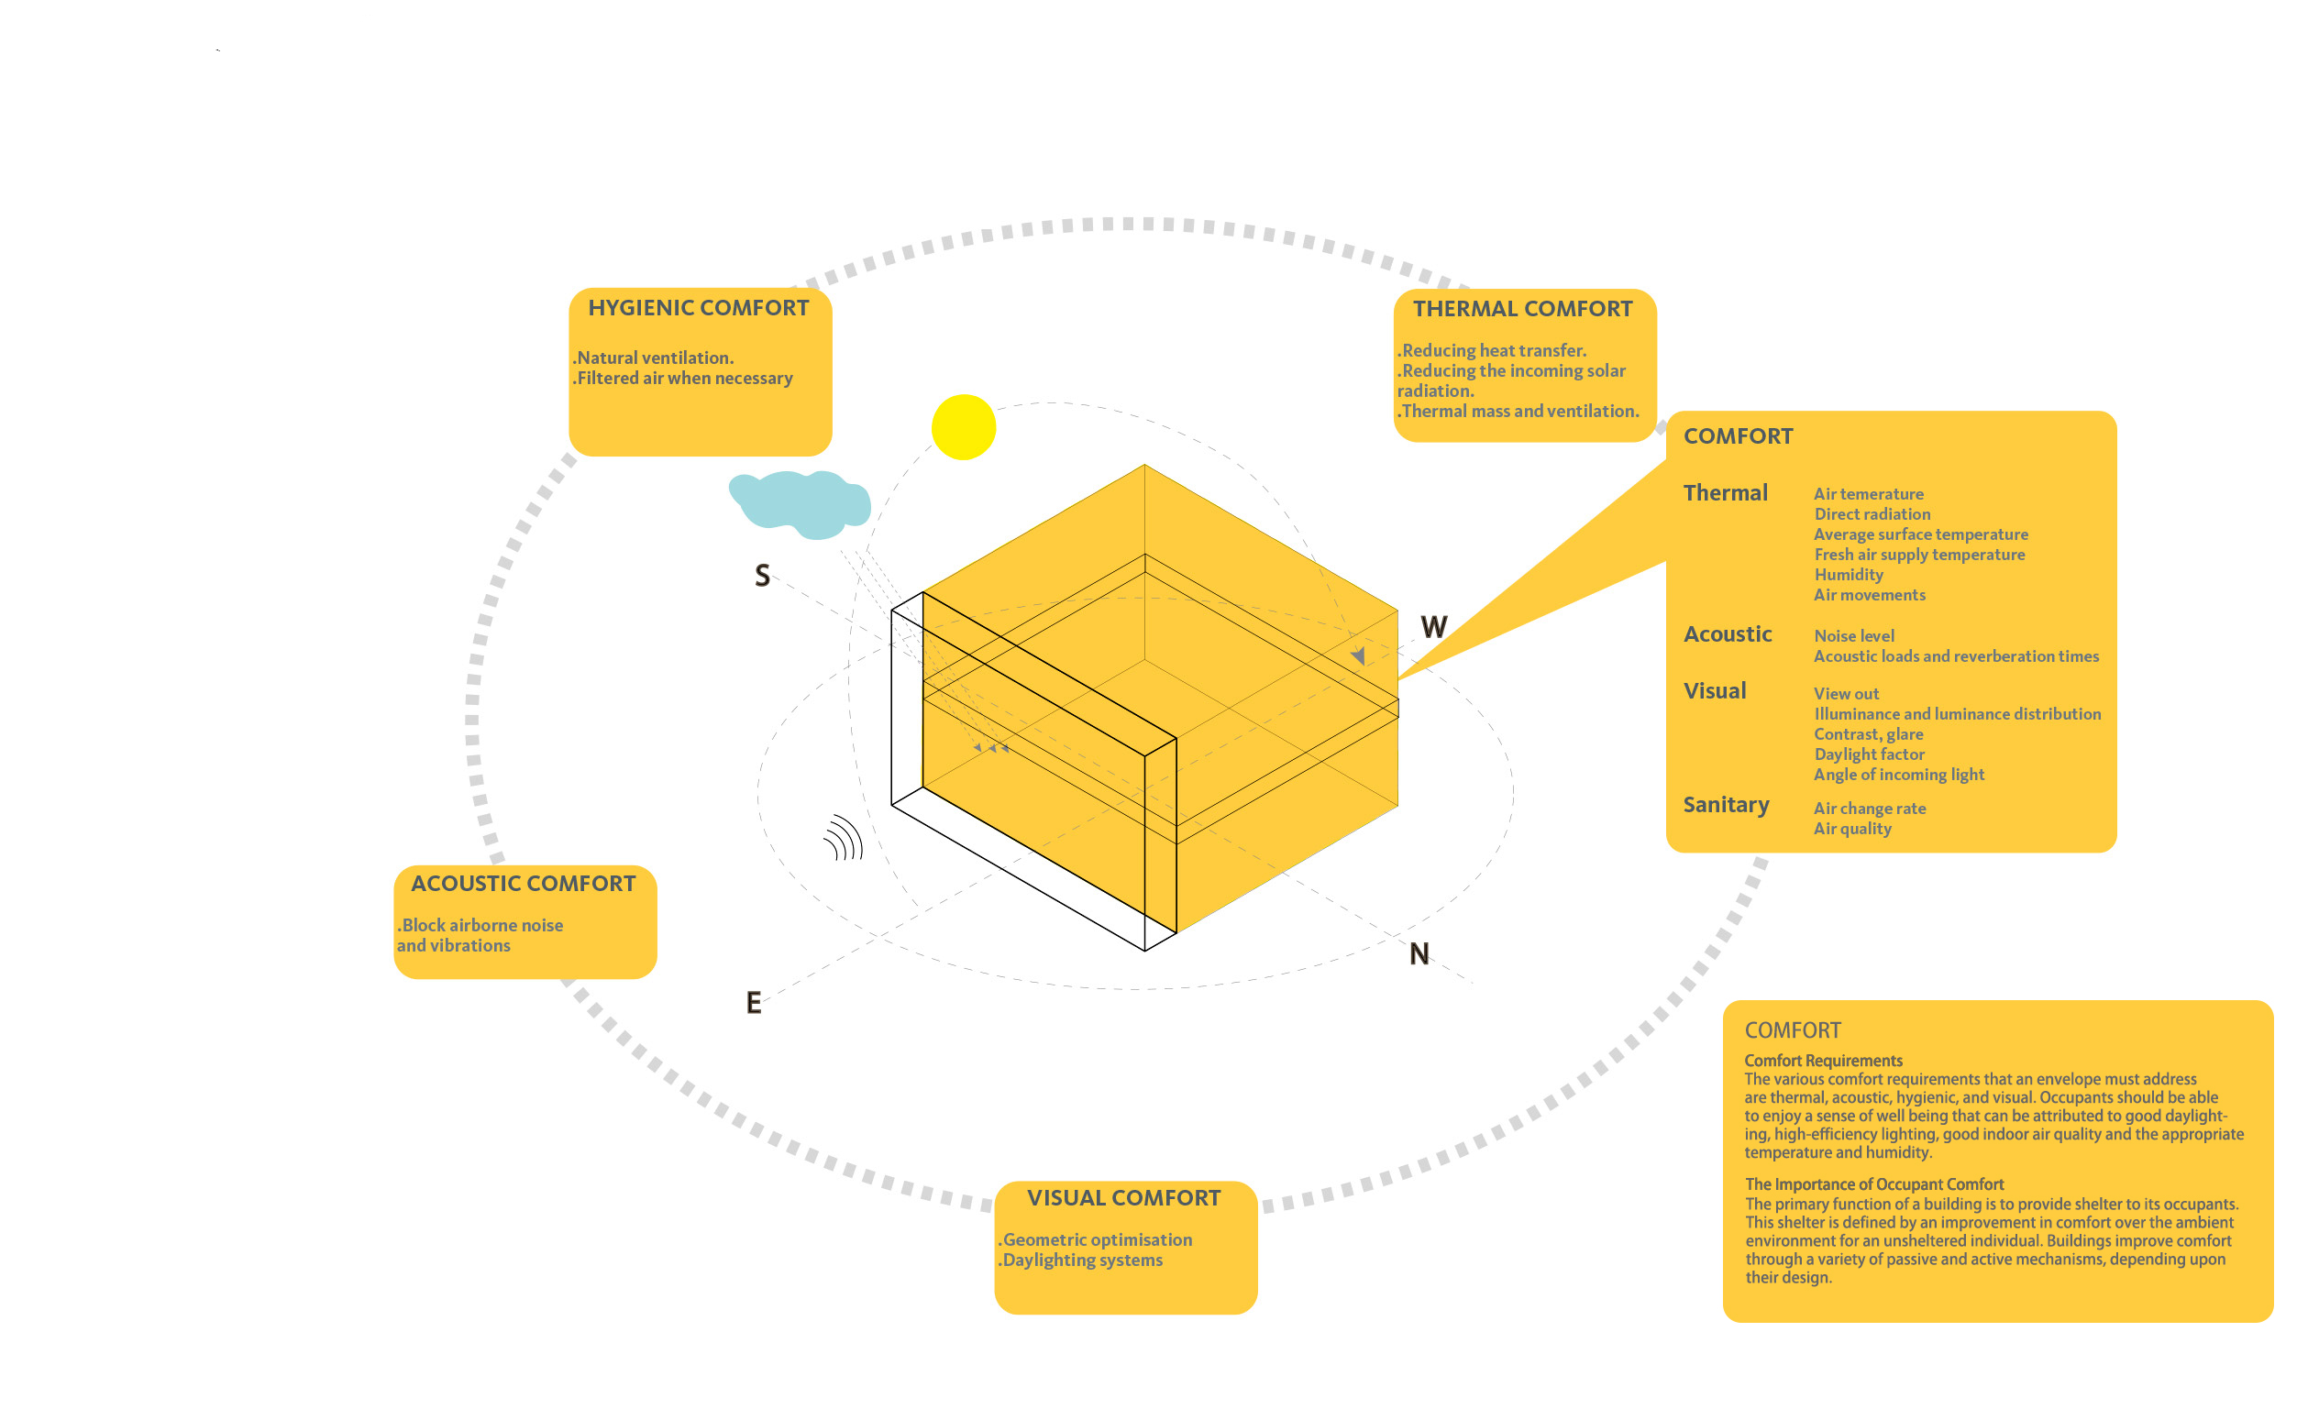
COMFORT DRIVERS

Slide 3
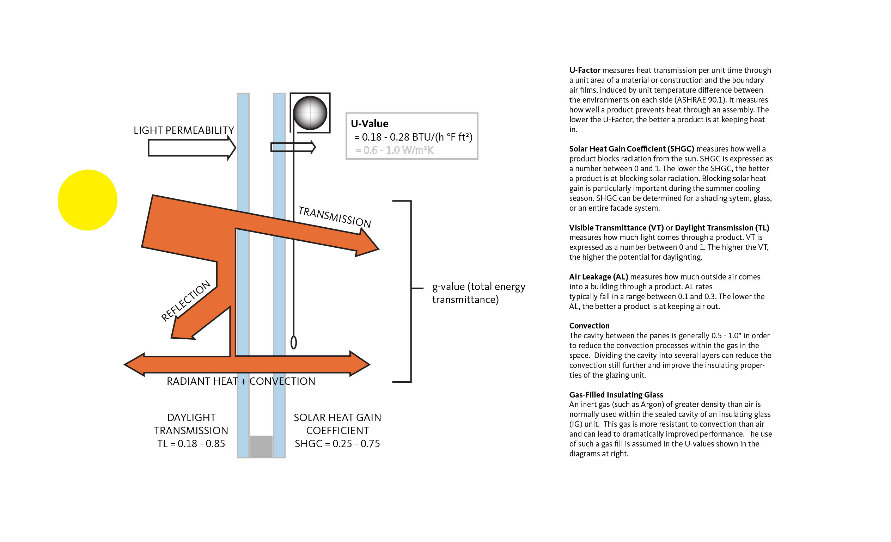
THERMAL DRIVERS

Slide 4
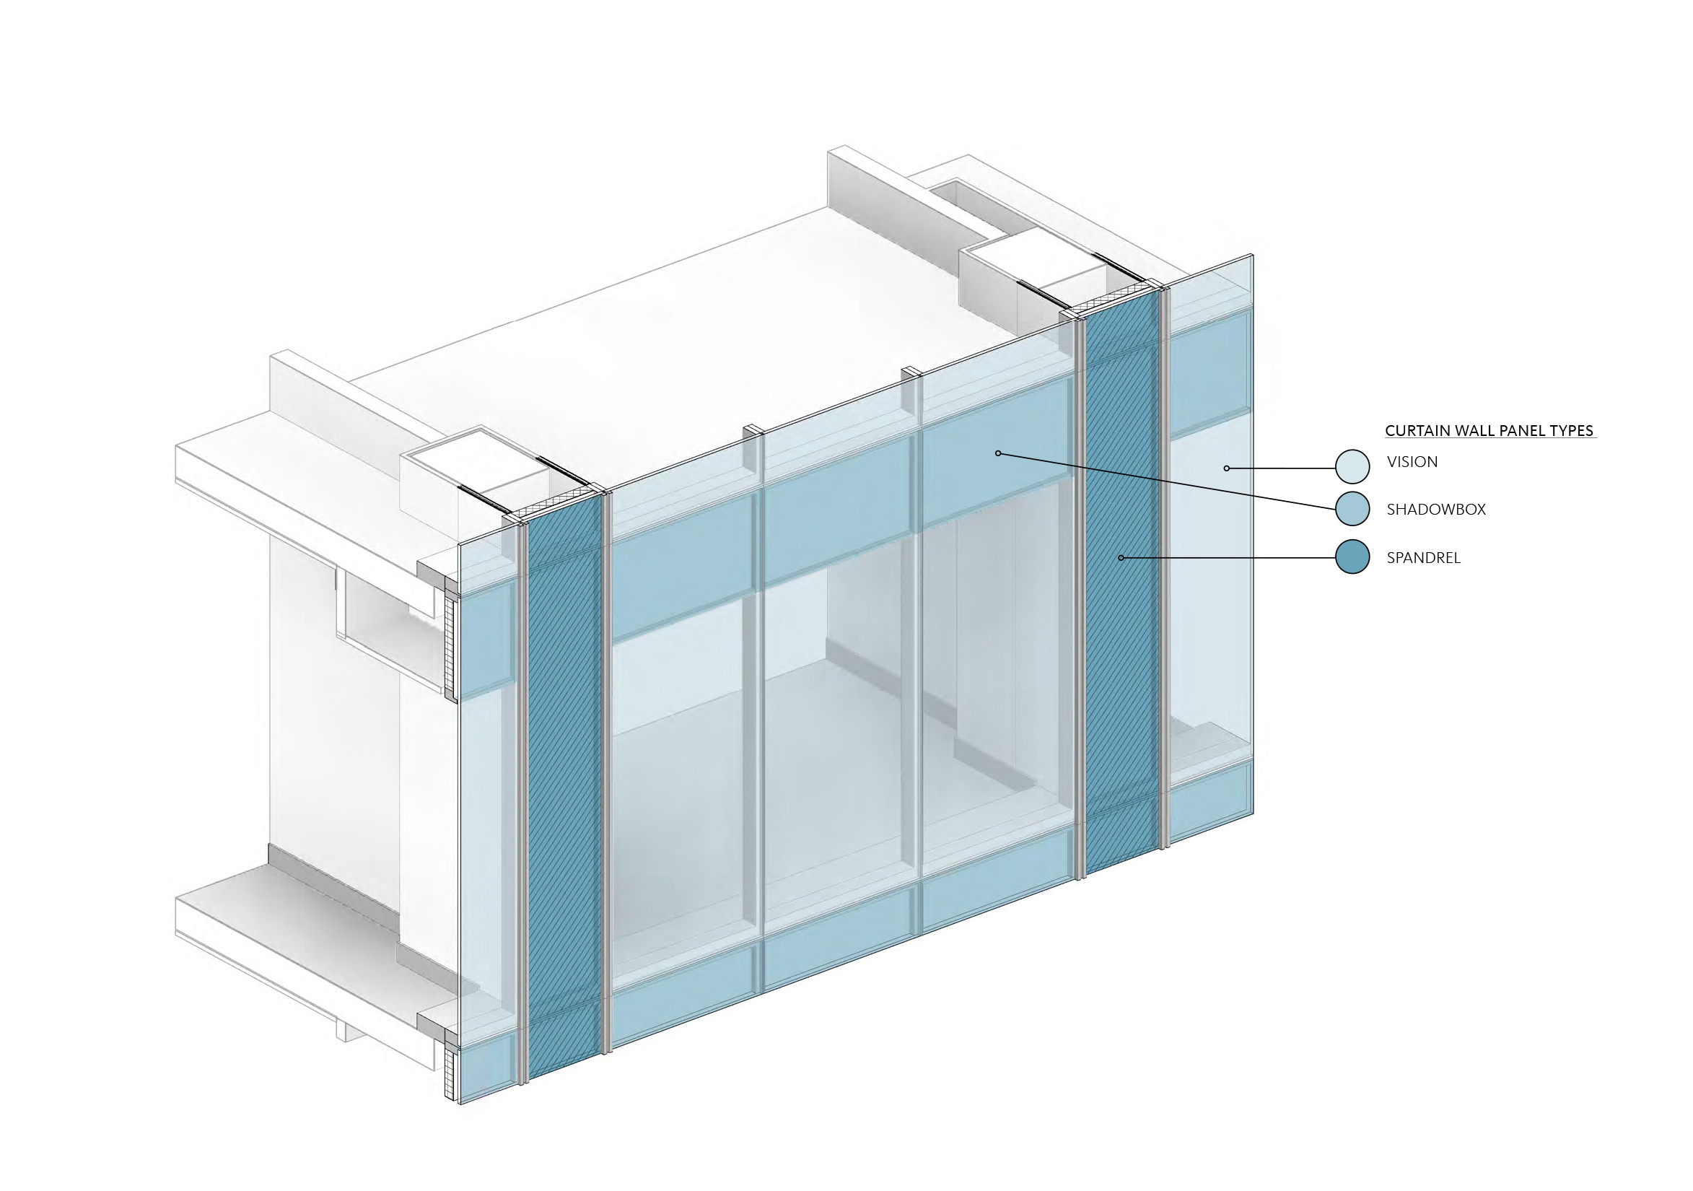
VISUAL DRIVERS

Slide 5
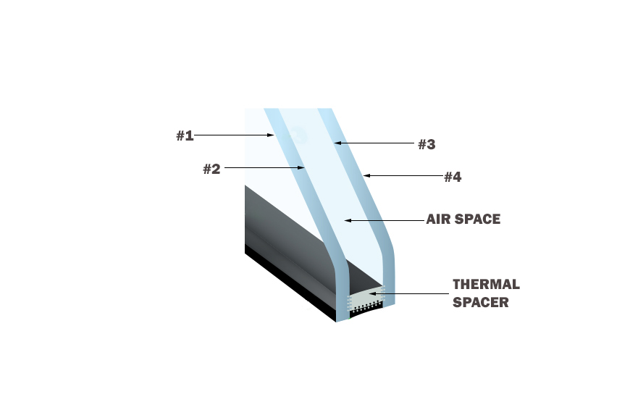
RAINSCREEN CURTAIN WALL SYSTEM
Premise To Direct Moisture Out
Primary lines of weather defense at back plane of glass
Secondary line of defense at the face of the glass
Insulating Glass Unit
Two plies of ¼” glass and one ½” sealed air space
U-Value Summer – 0.20
Winter - 0.24
Coatings
Thin layer of metal applied to improve Solar Heating Coefficient performance
Coatings on #2 and #3 surface
SHGC 0.29 – 0.24
Transmittance visible 38% - 47%
UV 7%
Argon Air Space
Argon offers lower thermal conductivity than air
Spacer
Warm edge thermal spacer
Condensation Resistance Factor 60
Acoustic
Outside – Inside Transmission Class 29

Slide 6
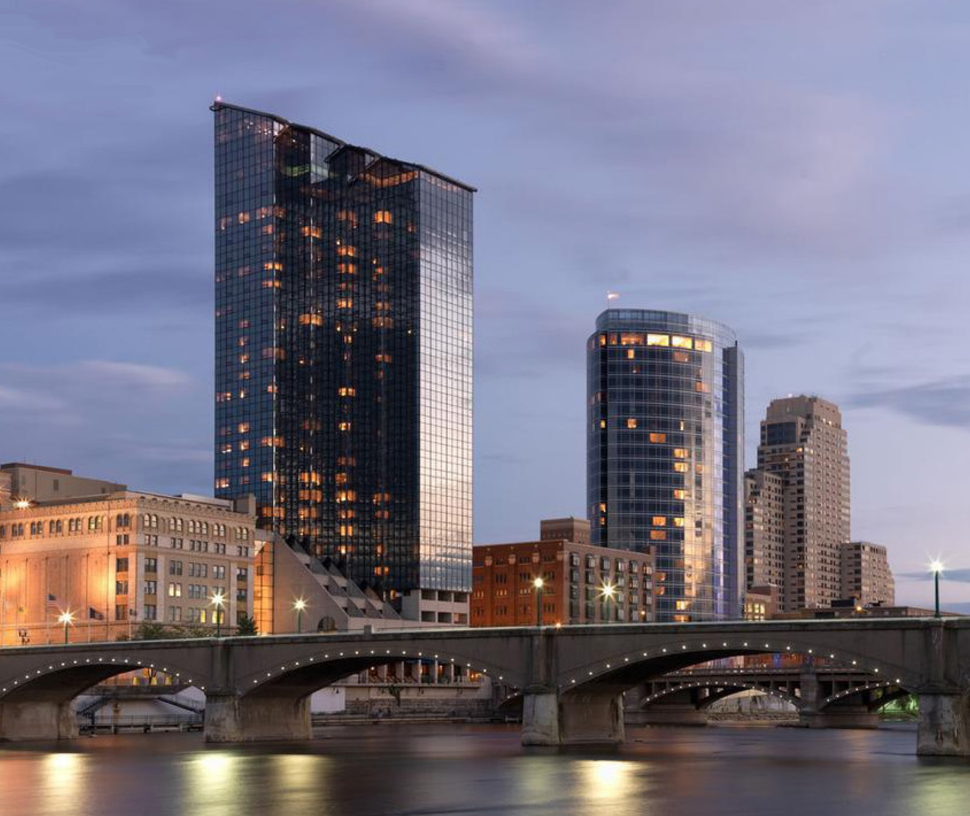
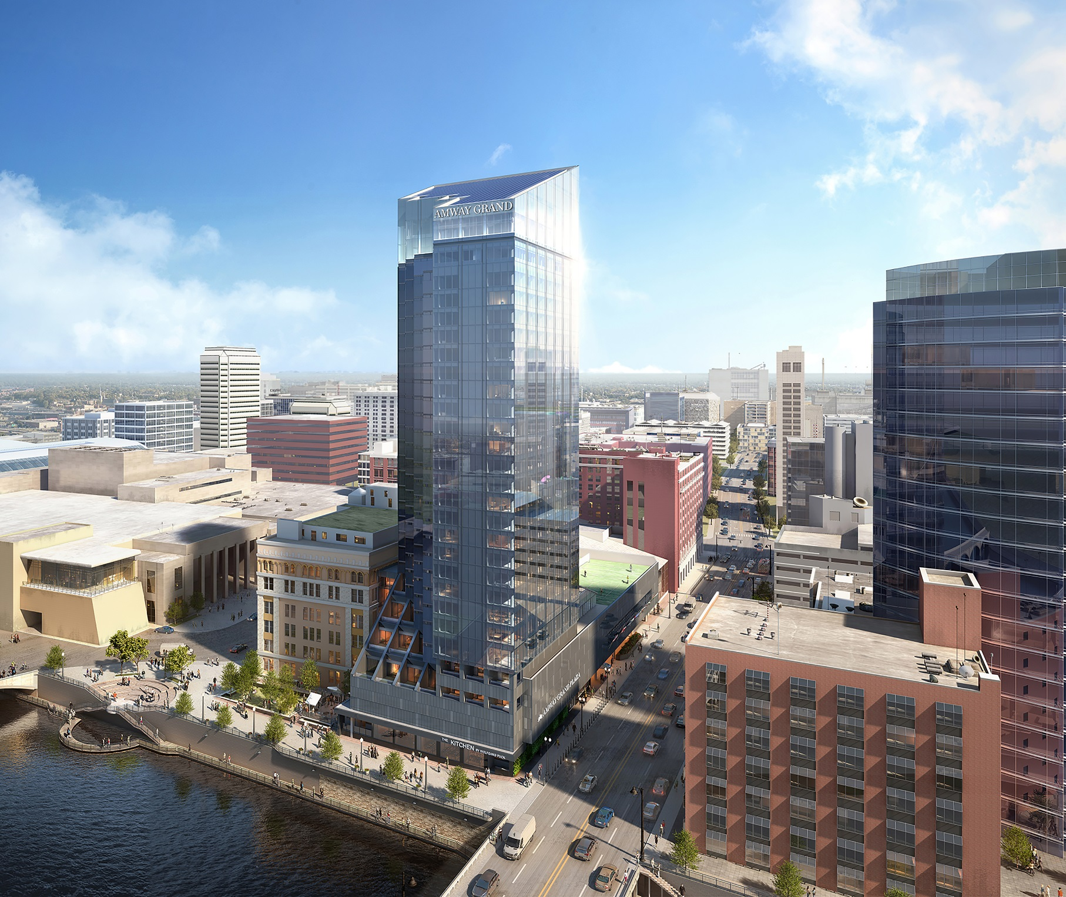
ENERGY PERFORMANCE MODEL AT DESIGN DEVELOPMENT
Reference 2015 Michigan Energy Code
EXISTING GLASS MODEL
NEW GLASS MODEL
Glass Properties
U-0.47
SC-0.50
Glass Properties
U-0.26
SC-0.25

Slide 7
DEEP ENERGY RETROFIT
Reduced KW/T With Chiller Replacement
Reconfigured Hydronic Net Horsepower Reduction
New Cooling Tower Net Reduced Horsepower, Water Consumption and Treatment Chemicals
Room Exhaust Heat Recovery
Central Air Handling Replacing Perimeter Heat Pumps
Heat Recovery For Domestic Hot Water Heating
VFD Efficiencies
BMS Consolidation
Heat Recovery unit for pool / fitness
Estimated Annual Savings $113,000

